Slide 1
Predictive Analytics and Recommendation Systems in Banking

Slide 2
Project Overview
Objective:
To utilize machine learning techniques to:
Minimize financial risk
Improve customer satisfaction
Optimize product offerings
Core Components:
Supervised Learning: Predict loan defaults
Unsupervised Learning: Segment customers
Recommendation Engine: Suggest personalized banking products

Slide 3
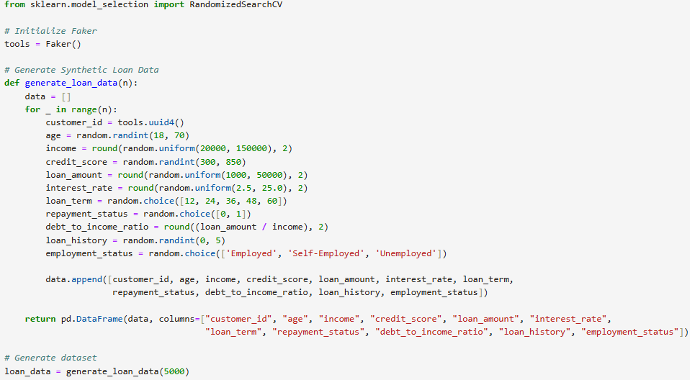
Synthetic Loan Data Generation
Libraries Used
Faker: To create realistic but fake customer IDs.
pandas / numpy: For data handling and numerical operations.
random: To generate randomized values for features.
Generate a realistic synthetic dataset that simulates loan applications using Python libraries.
Creates a tool to generate fake unique customer identifiers (UUIDs).
This function creates n synthetic customer records.
All generated records are returned as a pandas DataFrame for easy use in modeling.
Generates 5,000 customer records to simulate a real-world loan portfolio.

Slide 4
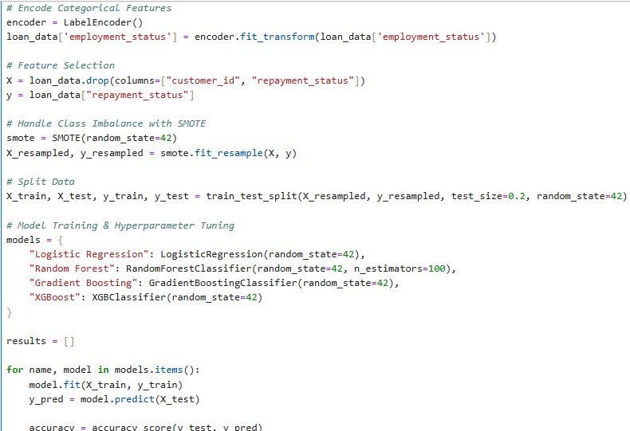
Loan Default Prediction – Modeling Pipeline
Converts employment_status (e.g., "Employed", "Unemployed") into numeric form.
Balances the dataset by synthesizing new minority class samples.
Important because loan defaults are usually rare (imbalanced data).
Splits the data into:
80% training set
20% testing set
Trains 4 different machine learning models.
Compares them on key metrics like Accuracy, Precision, Recall, F1-Score, and AUC.

Slide 5
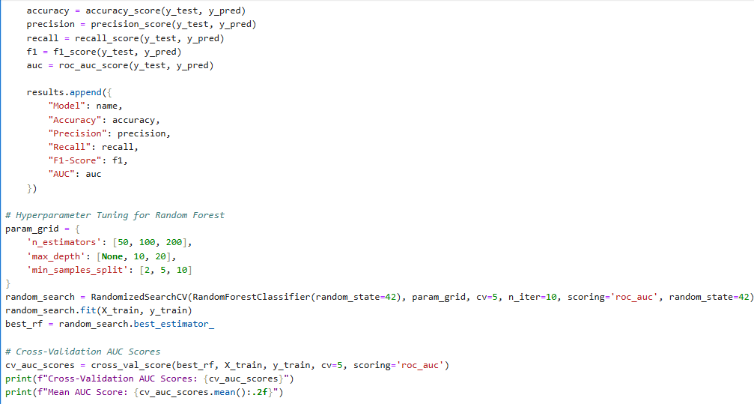
Each model is trained and evaluated on the test set.
Tries different combinations of parameters (e.g., tree depth, number of trees).
Uses 5-fold cross-validation and ROC AUC as the scoring metric.
Finds the best-performing Random Forest model.
Evaluates the tuned model on multiple train/validation splits.
Prints the AUC scores and their average (mean model performance).

Slide 6
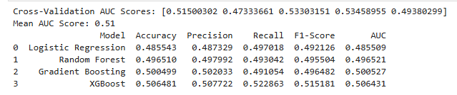
REASON FOR LOW PERFORMANCE
No Meaningful Patterns in Data
Machine learning models learn from patterns and relationships in the data.
However, Faker generates data randomly, meaning there is no real correlation between features (age, income, credit score, etc.) and the target variable (loan default).
The model is essentially making random guesses, leading to an AUC close to 0.5, which is equivalent to random prediction.
This results in poor generalization of the model.

Slide 7
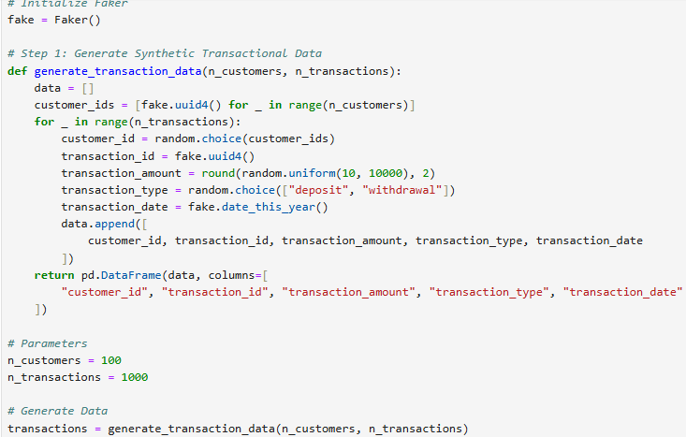
Generating Synthetic Transactional Data
This function generates a synthetic dataset of banking transactions.
Randomly selects a customer ID from the previously generated list.
This ensures that transactions are distributed among different customers.
Generates a random transaction date within the current year.
Defines the number of customers (100) and the total transactions (1000).

Slide 8
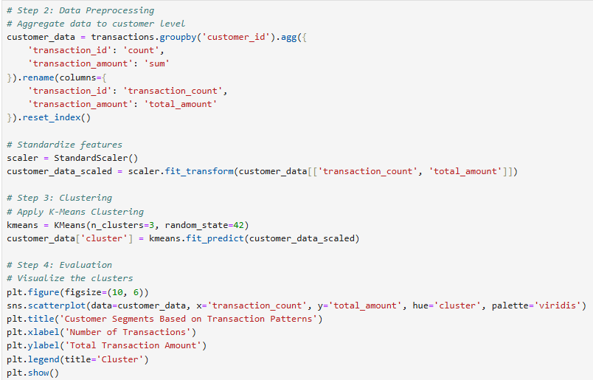
K-Means clustering is sensitive to scale—features with larger values (e.g., total_amount) can dominate those with smaller values (transaction_count).
Aggregates transactional data at the customer level.
Standardizes features for fair comparison.
Uses K-Means to segment customers into 3 groups.
Visualizes clusters to understand different spending behaviors.

Slide 9
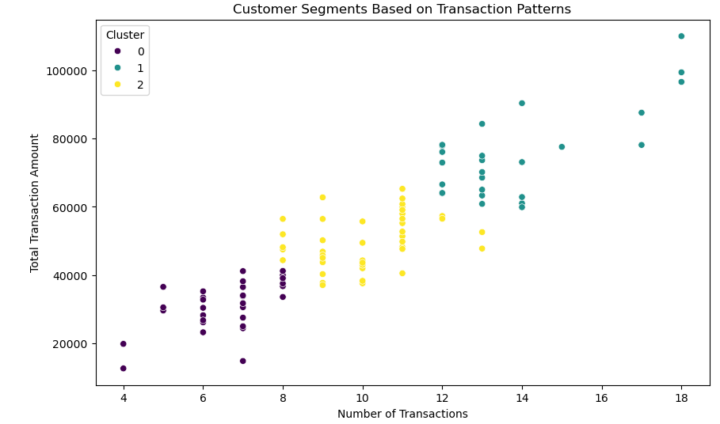
Distinct Segmentation:
The clusters are well-separated, indicating that the K-Means model has successfully grouped customers with similar spending behaviors.
Progression in Spending Behavior:
Cluster 0 (Purple - Low Transactions & Low Amounts): These customers have low engagement (fewer transactions and lower spending).
Cluster 2 (Yellow - Moderate Transactions & Spending): These customers are in the mid-range.
Cluster 1 (Green - High Transactions & High Spending): These customers are high-value customers with frequent transactions and large spending amounts.
Marketing & Business Strategy Insights:
Cluster 1 (High-Value Customers): Can be targeted with premium offers & loyalty programs.
Cluster 0 (Low-Value Customers): May need incentives like discounts or promotions to increase engagement.
Cluster 2 (Moderate Customers): A good segment for upselling financial products.

Slide 10
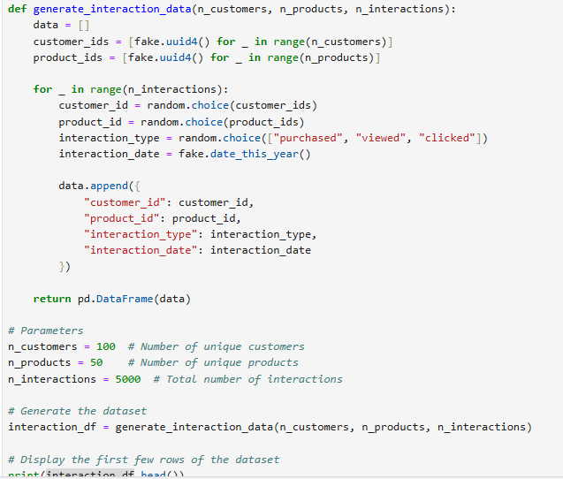
Generating Synthetic Customer-Product Interaction Data
This script generates synthetic interaction data between customers and products using the Faker library. The dataset simulates real-world customer-product interactions such as purchases, views, and clicks.

Slide 11
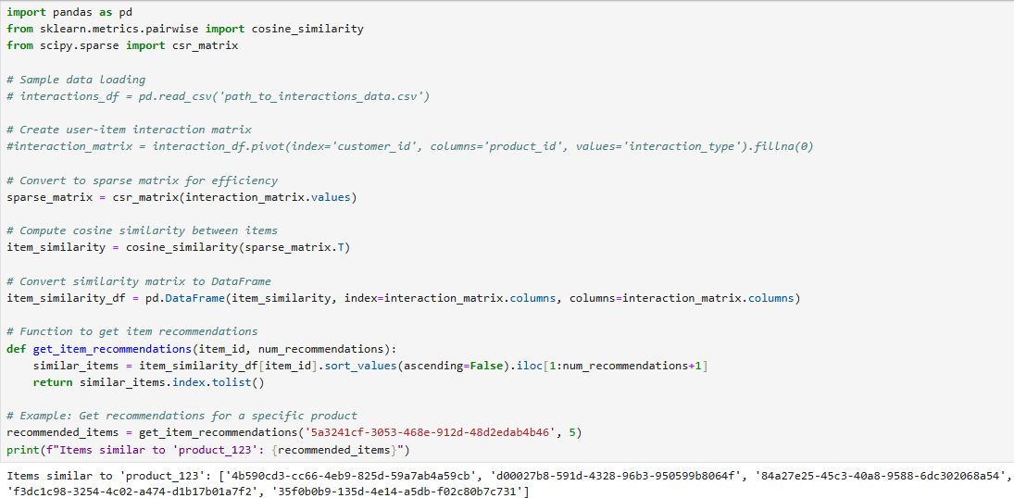
This script implements an item-based recommendation system using cosine similarity. It computes similarity between products based on user interactions and recommends similar products.
Computes cosine similarity between product vectors (columns of the interaction matrix).
Higher similarity means two products are often interacted with by the same users.
Finds num_recommendations most similar products to a given product.
Sorts by highest similarity scores

